Slide 1
ASP.NET Core And Web API
Hariharasudhan C
Karthikkannan M

Slide 2
.NET Core Overview
New version of .NET Framework, which is a free, open-source, general-purpose development platform maintained by Microsoft.
It is a cross-platform framework that runs on Windows, macOS, and Linux operating systems.
.NET Core Framework can be used to build different types of applications such as mobile, desktop, web, cloud, IoT, machine learning, microservices, game, etc.
.NET Core application speed up the performance, reduce the memory footprint and becomes easy to maintain.

Slide 3
Why Use .NET Core?
Cross platform
Unified
Better performance
Lightweight
Dependency Injection
Hosting
Open Source
Testability
Side-by-side App Versioning

Slide 4
ASP.NET CORE
Smaller Deployment Footprint
Supports Multiple Platforms
Fast
IoC Container
Integration With Modern UI Frameworks
Hosting
Code Sharing

Slide 5
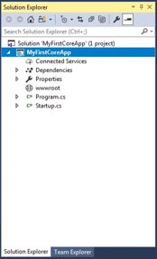
ASP.NET Core – Project Structure

Slide 6
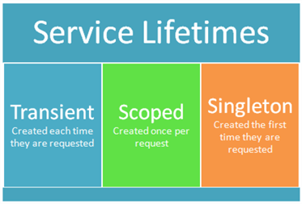
Dependency Injection

Slide 7
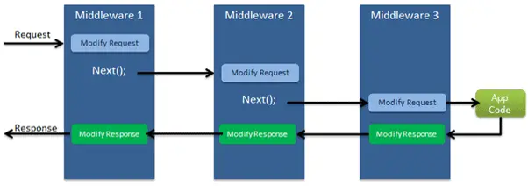
ASP.NET Core - Middleware

Slide 8
ASP.NET Core – Middleware Contd...
Middleware​ | Description​
Authentication​ | Adds authentication support.​
CORS​ | Configures Cross-Origin Resource Sharing.​
Routing​ | Adds routing capabilities for MVC or web form​
Session​ | Adds support for user session.​
StaticFiles​ | Adds support for serving static files and directory browsing.​
Diagnostics​ | Adds support for reporting and handling exceptions and errors.​

Slide 9
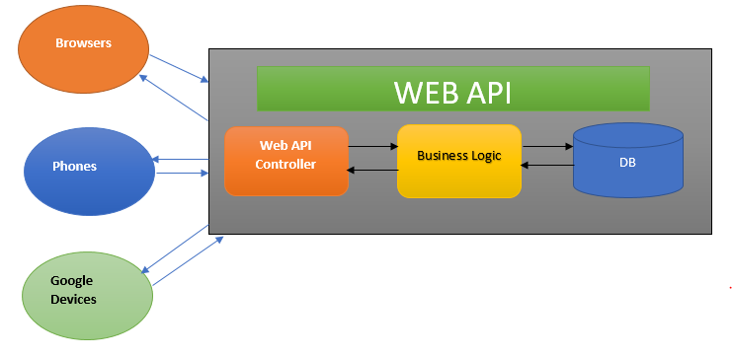
ASP.NET Core – Web API

Slide 10
Thank you

